Slide 1

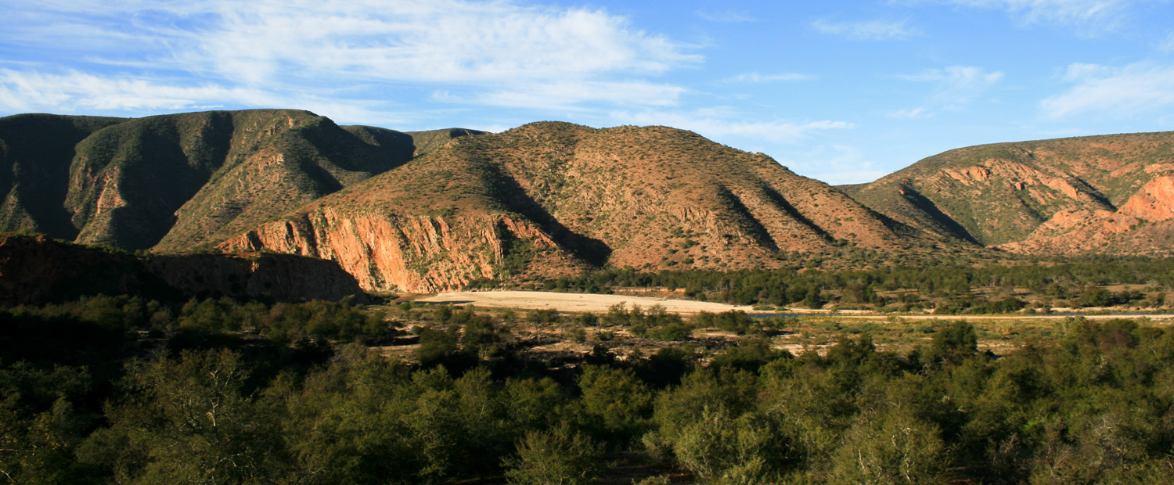

MAY 2017
Notes:
Living Lands is a not-for-profit organization for conserving and restoring living landscapes. A living landscape consists of a variety of healthy ecosystems and land uses, and is home to ecological, agricultural, and social systems which are managed so as to function sustainably. This ensures that natural and cultural resources are available for future generations and that the system is resilient for adaptation to climate change.
Our Vison:
‘Collaborations working on living landscapes’.
Our Mission:
To bring synergies and added value to the landscape through:
• Promoting living landscapes;
• Mobilising civil society for sustainability
• Enabling and facilitating social learning processes;
• Fostering mutually beneficial partnerships and participatory networks;

Slide 2
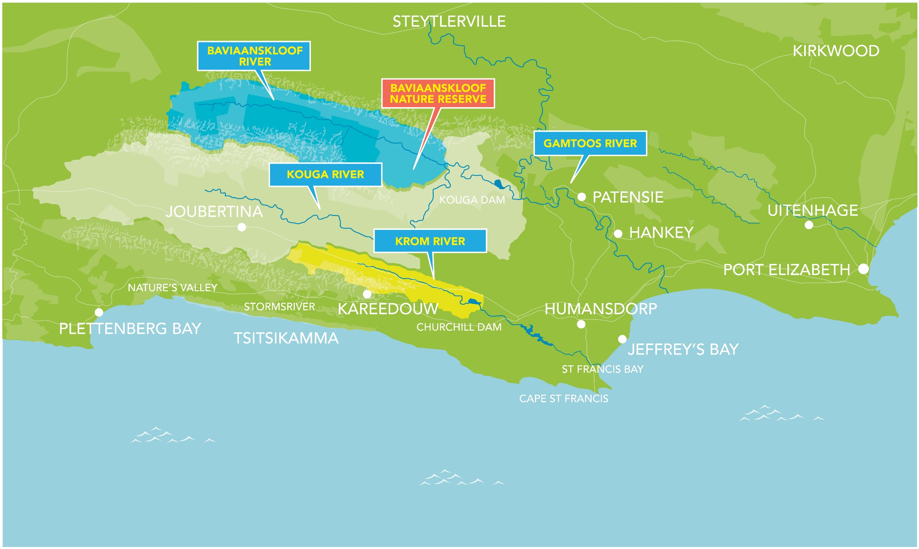
LANDSCAPES

Slide 3
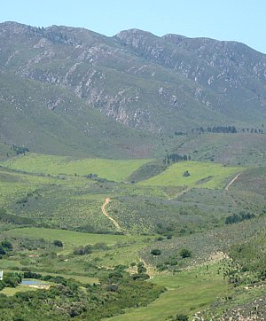
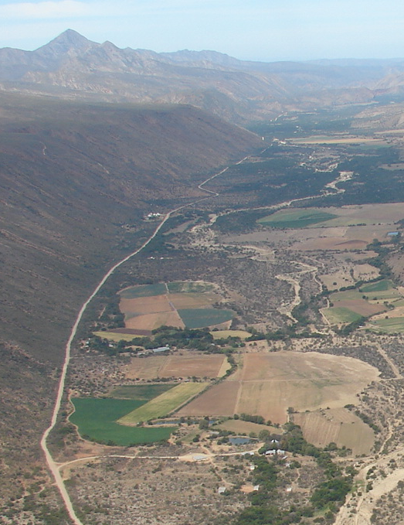
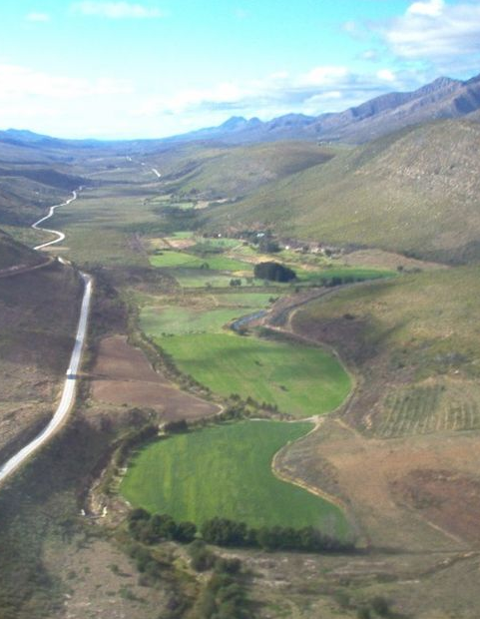
Landscapes
Kouga
Baviaanskloof
Krom

Slide 4
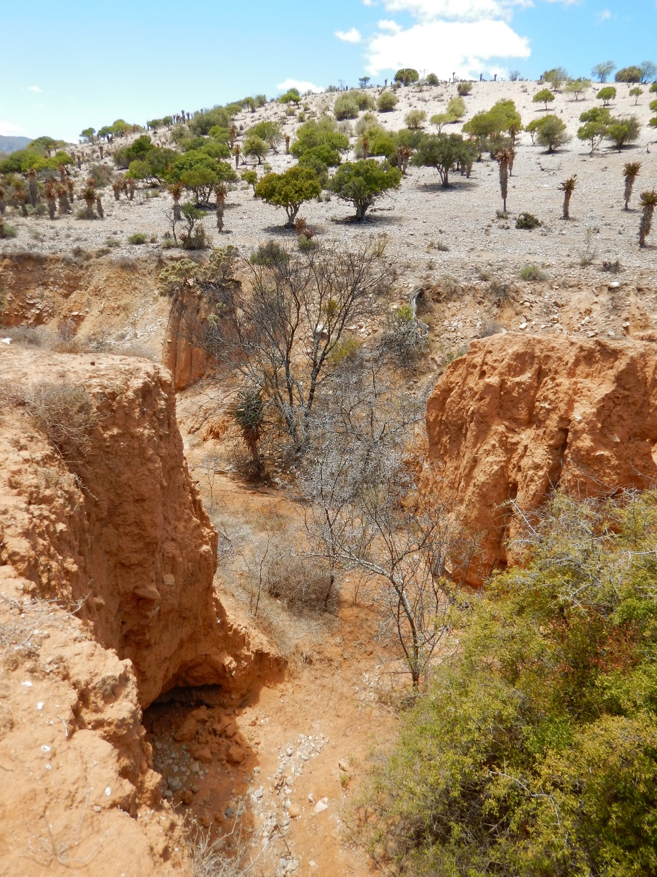
Student Research: Rehabilitation
Sheila de Leeuw:
Gully erosion mapping and rehabilitation
Joost Albers:
Investigating new innovations and possibilities for restoration in the thicket Biome in the Baviaanskloof that can be adapted to fit the local context
Ymkje van de Witte:
Can alien invasive trees fuel sustainable restoration in the Kouga catchment – South Africa
Andreas Baele:
Rehabilitation of riparian zones in the Langkloof

Slide 5
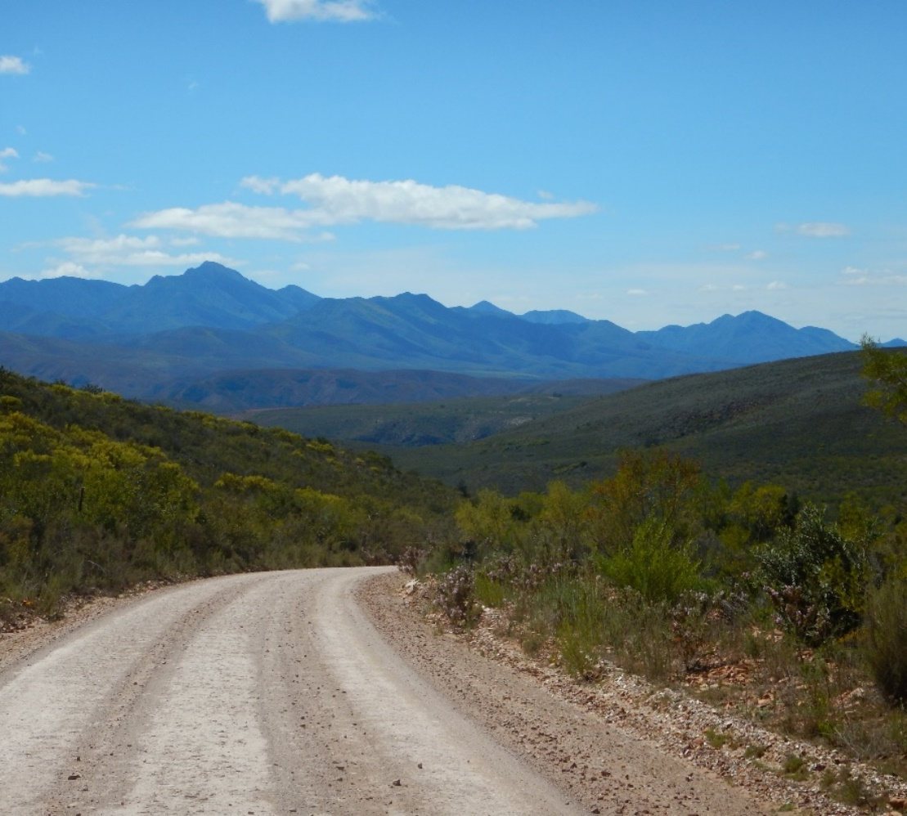
Student Research: Rehabilitation
James Mulkerrins:
Scale Framing in Processes of Landscape Restoration.
Quirine van der Meer:
Langkloof Restoration Plan
Virginie Zerroug:
Lacement d’un programme de restauration des paysages dans le basin hydrologique de Kouga en Afrique du Sud

Slide 6
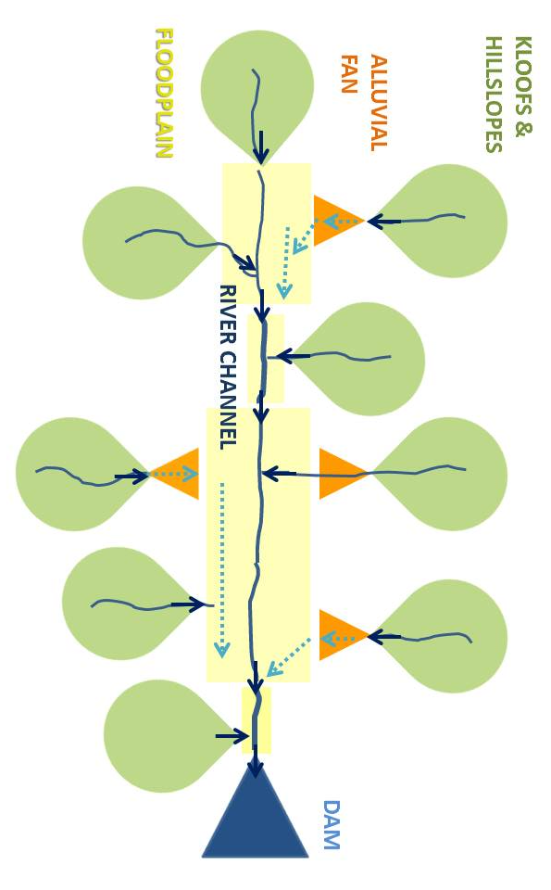
Student Research: Hydrology and Sociology
Julia Glenday:
Modeling the Hydrologic Impacts of Vegetation and Channel Network Change for a Semi-arid, Mountainous, Meso-scale Catchment: the Baviaanskloof, South Africa
Alanna Rebelo:
Hydrological responses of a valley-bottom wetland to land-use/land-cover change in a South African catchment: making a case for wetland restoration
Janina Klein:
Connecting different types of knowledge for the sustainable management of socio-ecological systems

Slide 7
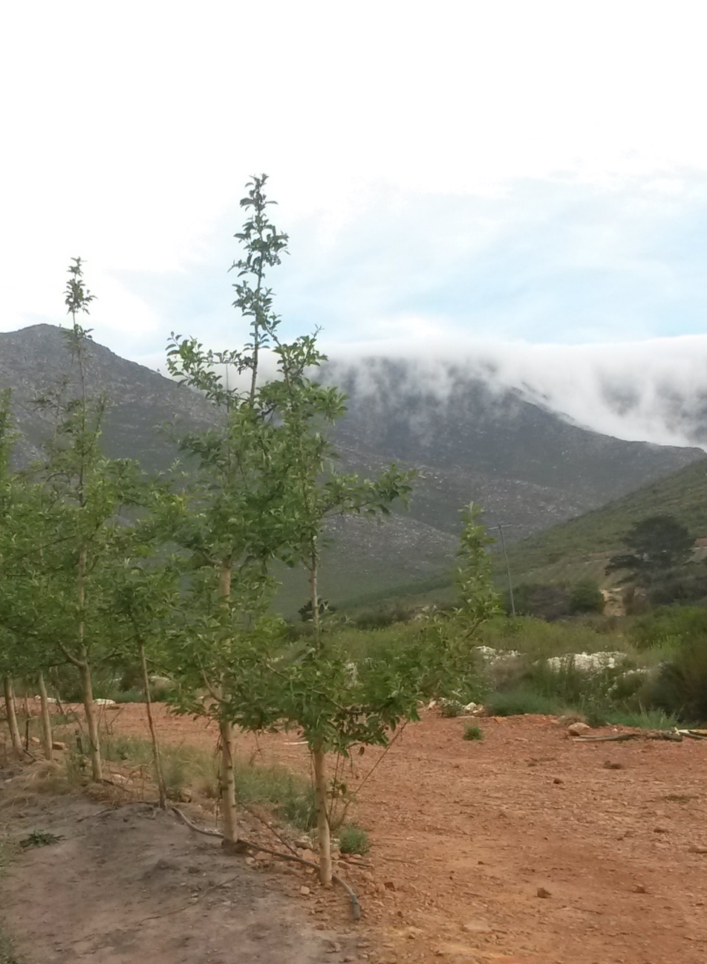
Student Research: Sustainability & Resilience
Larissa Koch:
Global and Local sustainability standards that are applied to farmers in the Kouga catchment
Arajan de Groot:
Effects of climate and ecosystem change in an agricultural valley in South Africa
Amilcar Valladares:
Effects of Ecosystem change on deciduous fruit farming in the Langkloof in South Africa
Bob Visser:
Redesign of an emerging farm in South Africa with the aim to reduce the vulnerability to hazards

Slide 8
Student Research: Permaculture & Tourism
Joost van Heiningen:
Exploring South African Nature Tourists’ Travel Motivations
Balndine Blachera:
Permaculture Garden Guide
Nelly Le Caroff:
Permaculture experiments at the Aandrus House - Langkloof

Slide 9
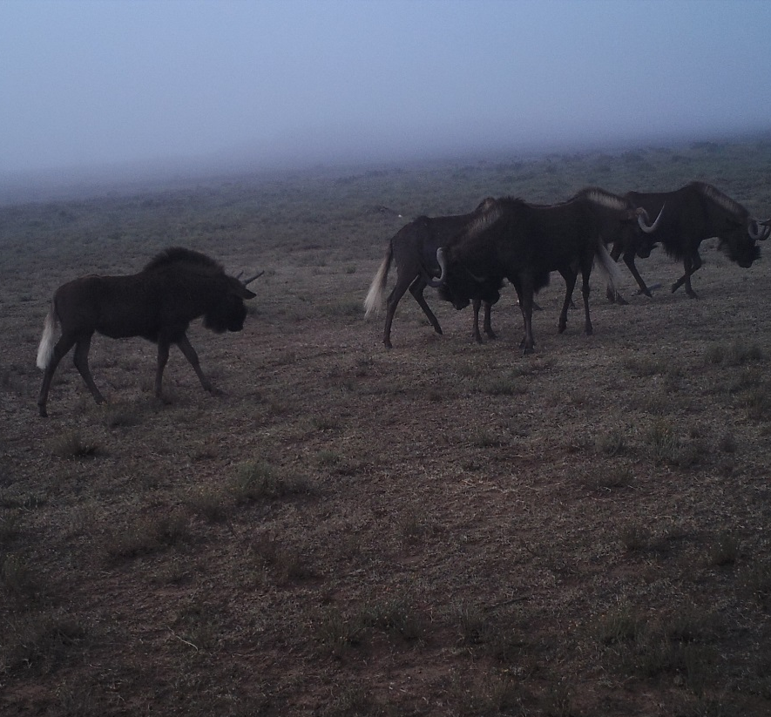
Student Research: Grazing & Habitat (other Landscapes)
Sofie te Wierik:
Assessing Eland Habitat Suitability
Abigail Maiden:
Assessing Habitat suitability for eland in the Compasberg Protected Environment
Jesse Hermens:
Grazing lawn usage by large herbivores
Vince Verpoort:
Common Eland Research Plan

Slide 10
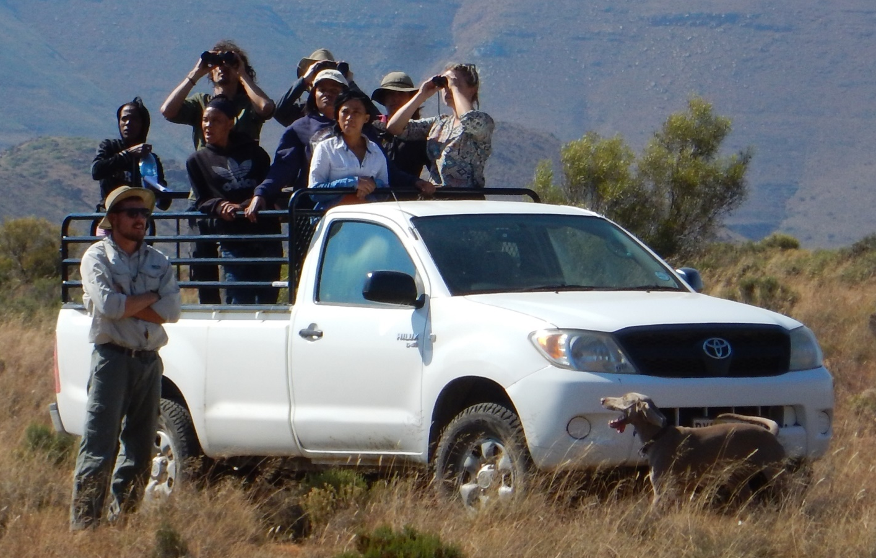
Current Research
8 International Students
2 PhD Students
2 MSc Students

Slide 11
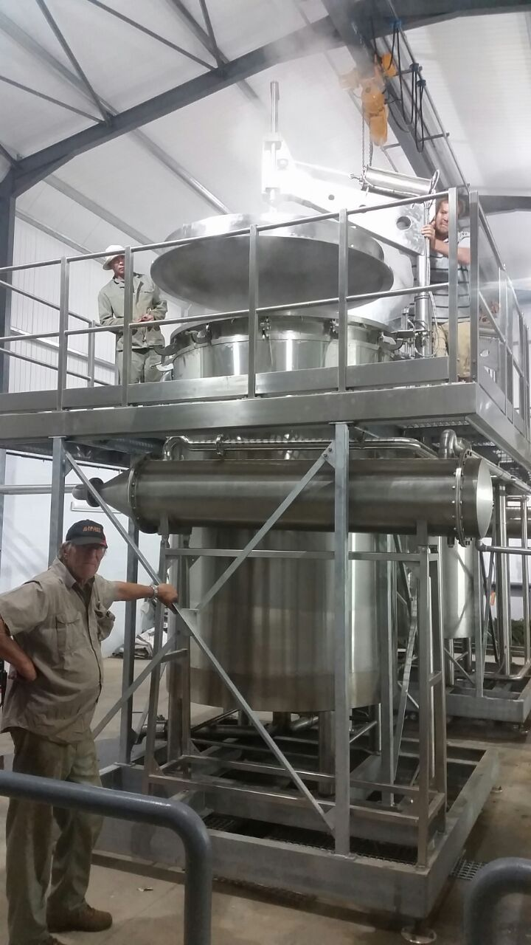
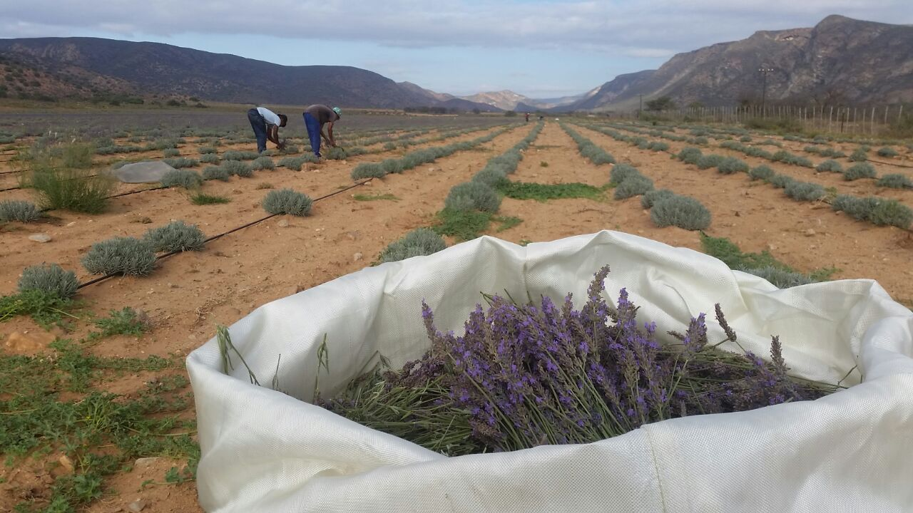
Current Projects: Baviaanskloof
LL & Grounded – business model - DEVCO
Essential oils to replace goats
48ha Lavandin; 30ha Rosemary
Processing Facility

Slide 12
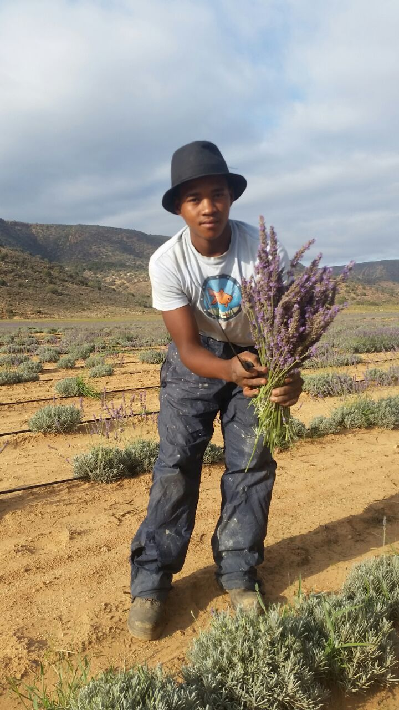
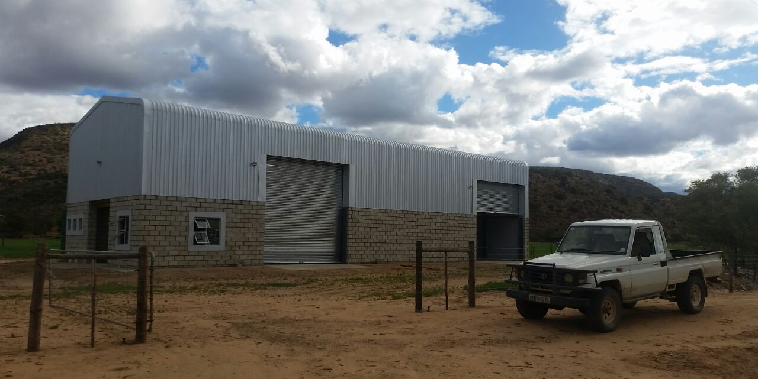
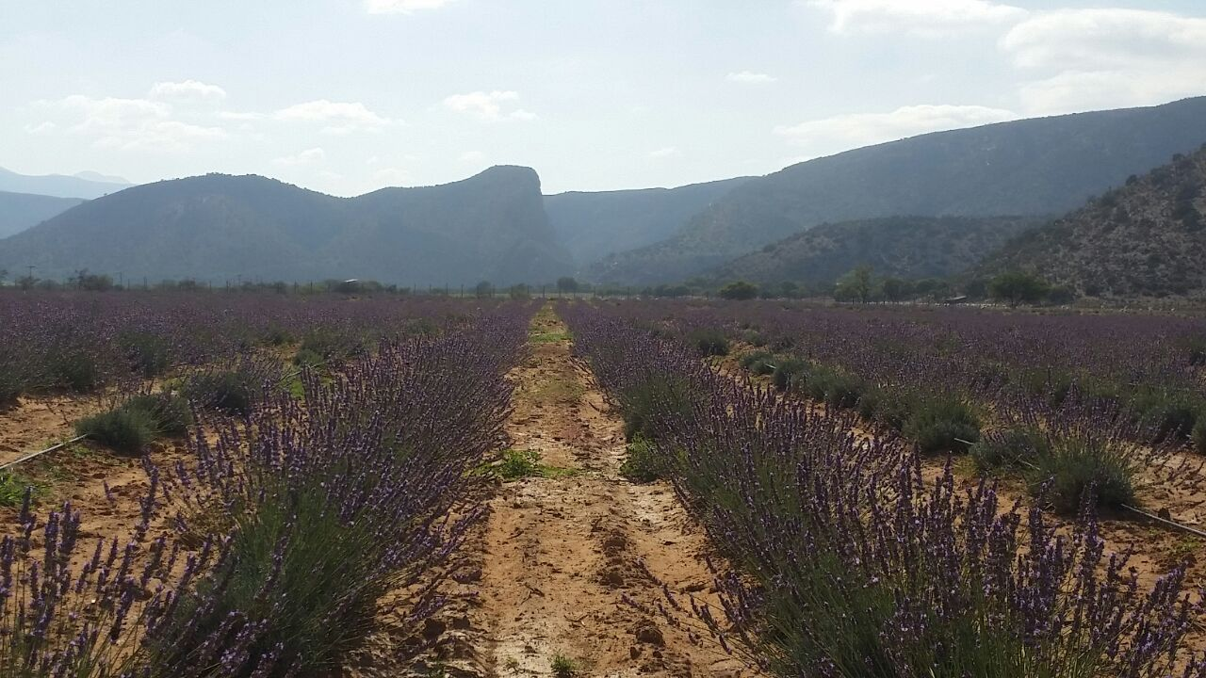
Current Projects: Baviaanskloof
Notes:
½ water vs lucern
Drippers 30% more effective than pivots

Slide 13
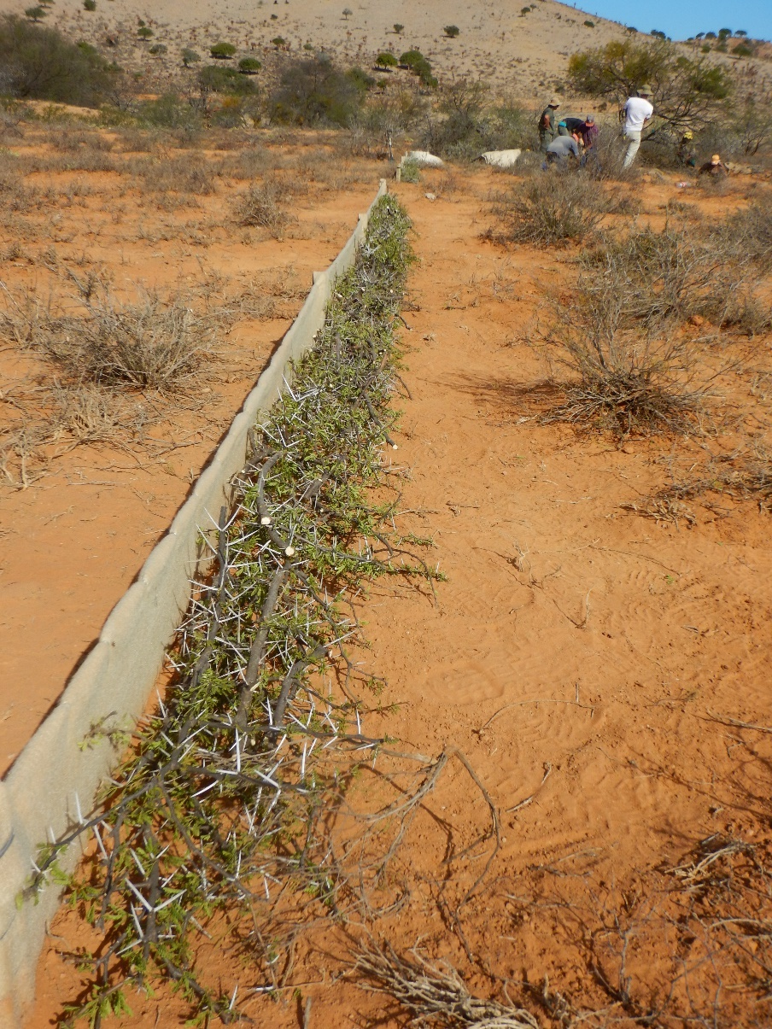
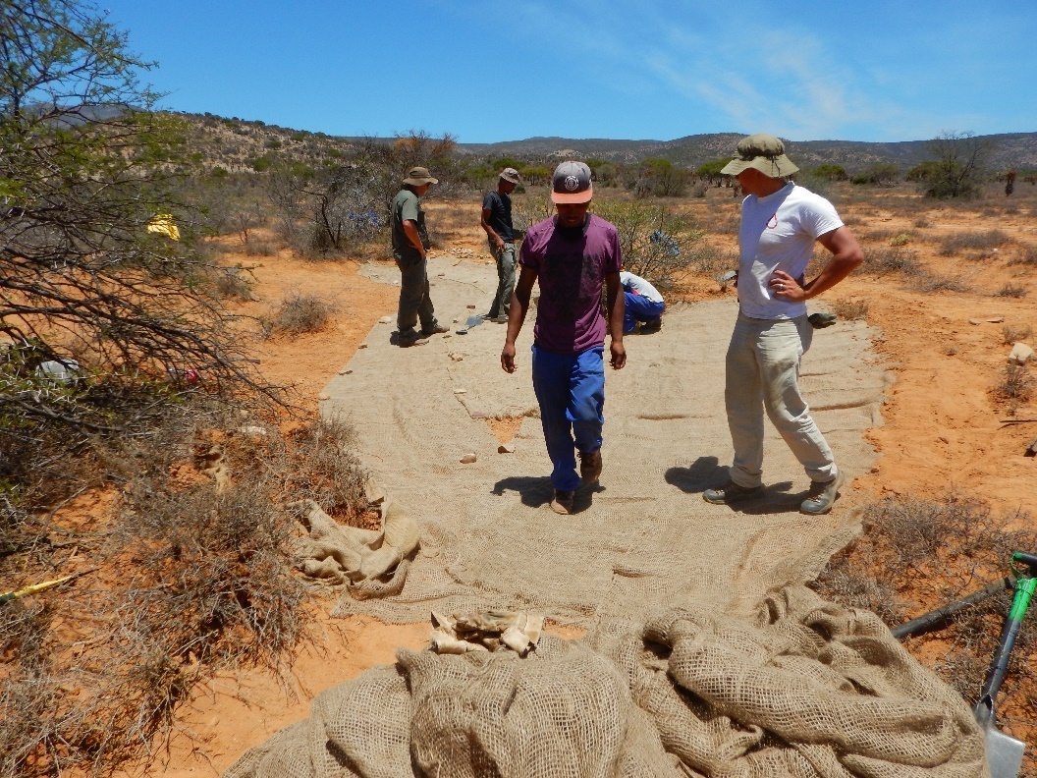
Current Projects: Baviaanskloof
Cocal Cola Africa Foundation & GEF
Restore 2500ha
5 alluvial fans

Slide 14
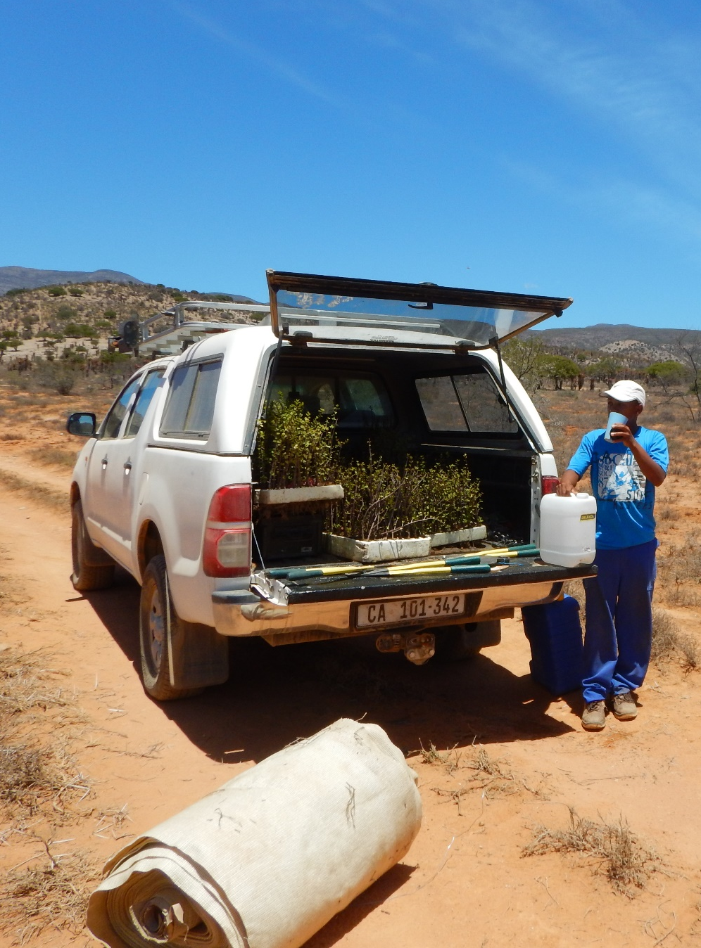
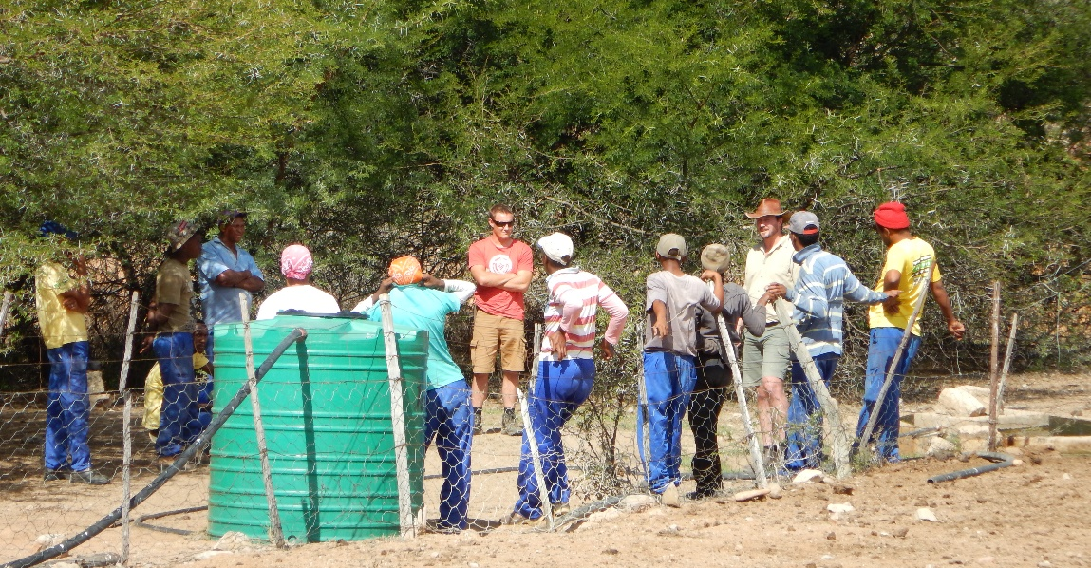
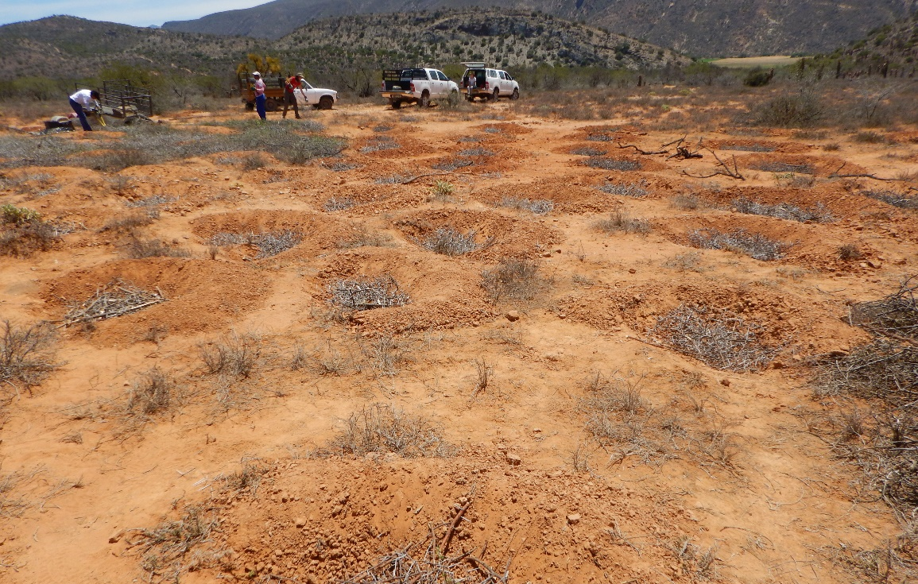
Current Projects: Baviaanskloof

Slide 15
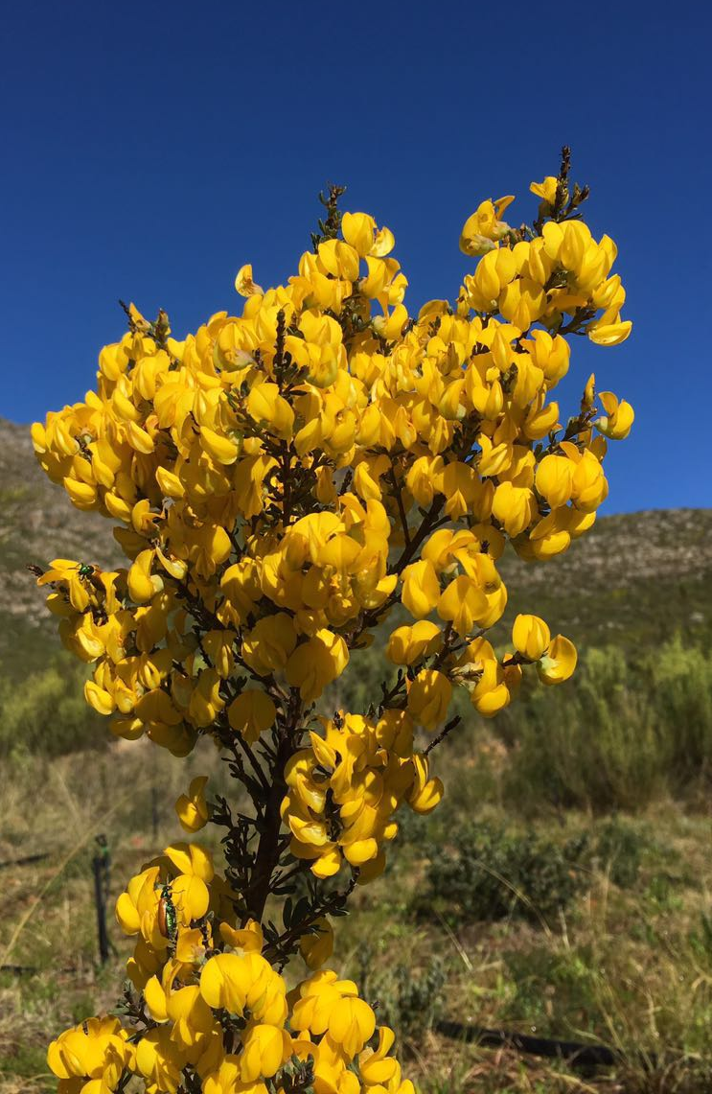
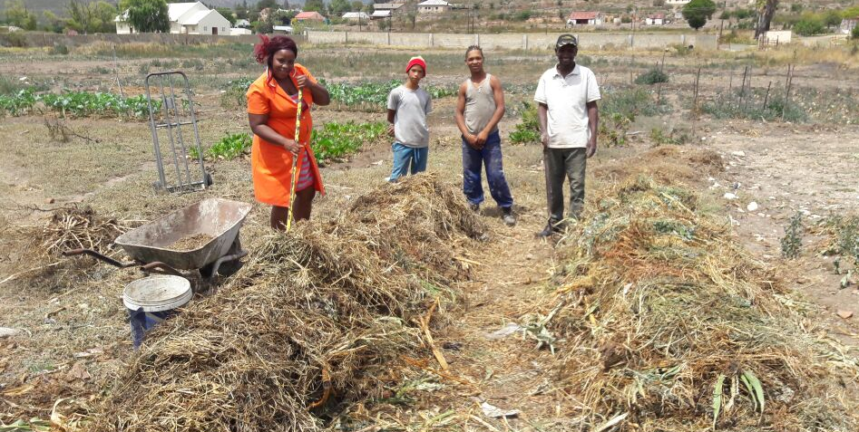
Current Projects: Langkloof
Switch Africa Green
Development of green economy through:
Sustainable agriculture
Environmental Restoration
Value-adding Businesses
Landscape Organisation

Slide 16
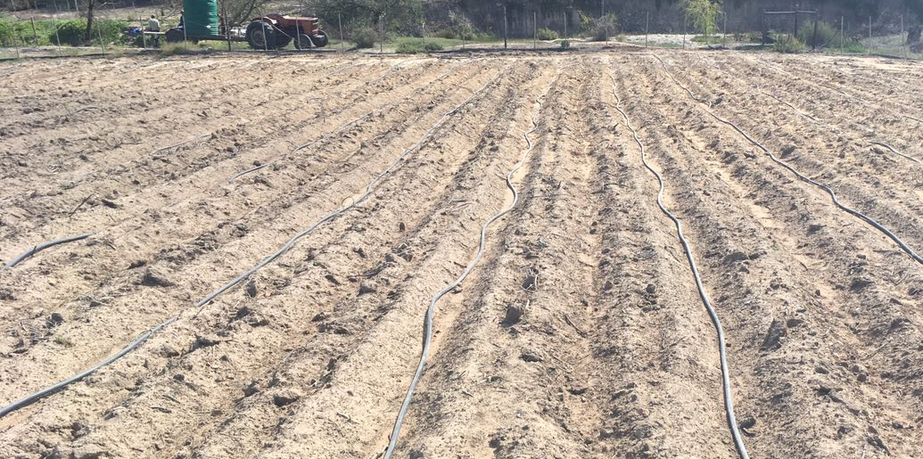
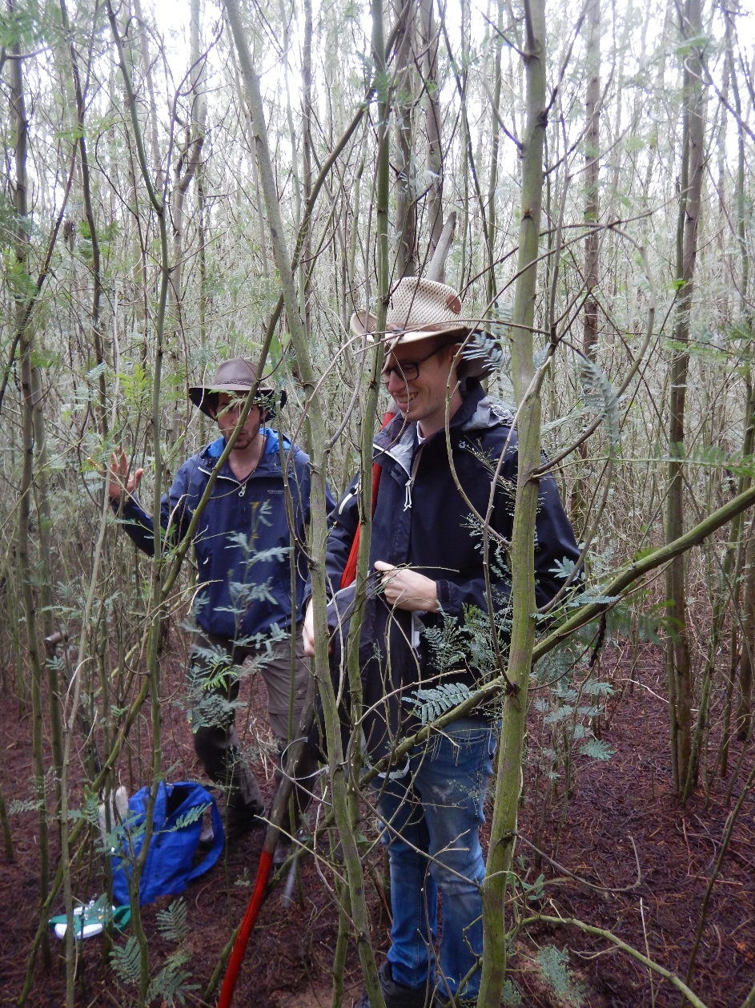
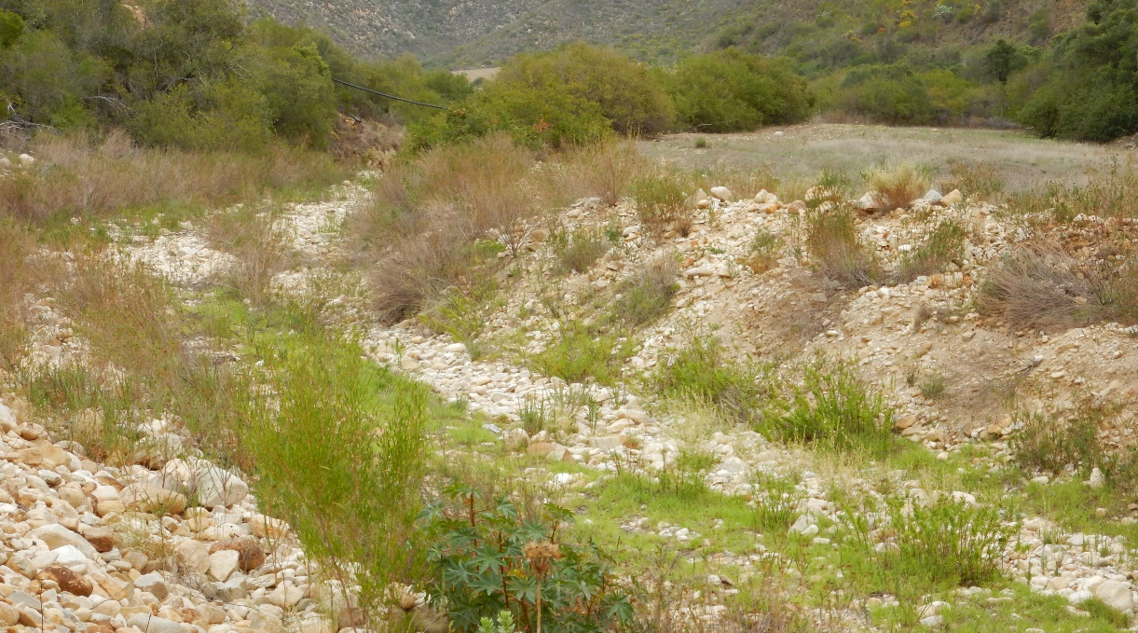
Current Projects: Langkloof

Slide 17
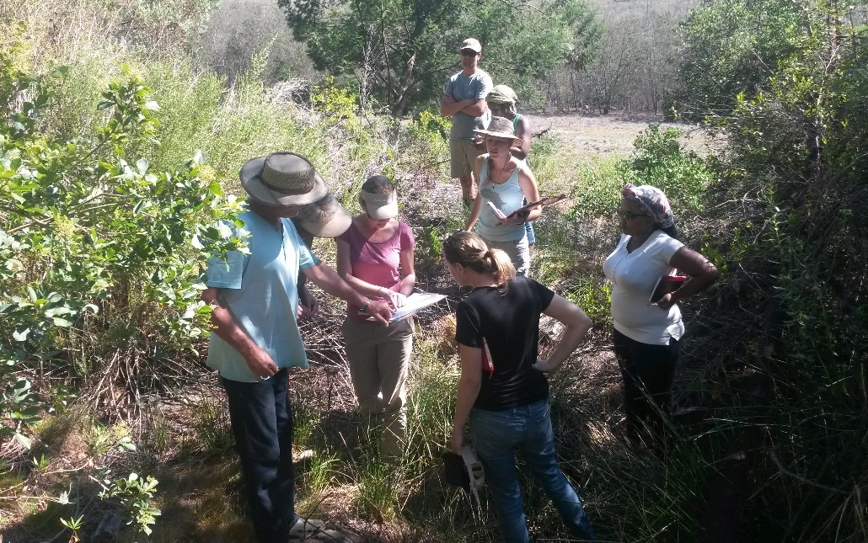
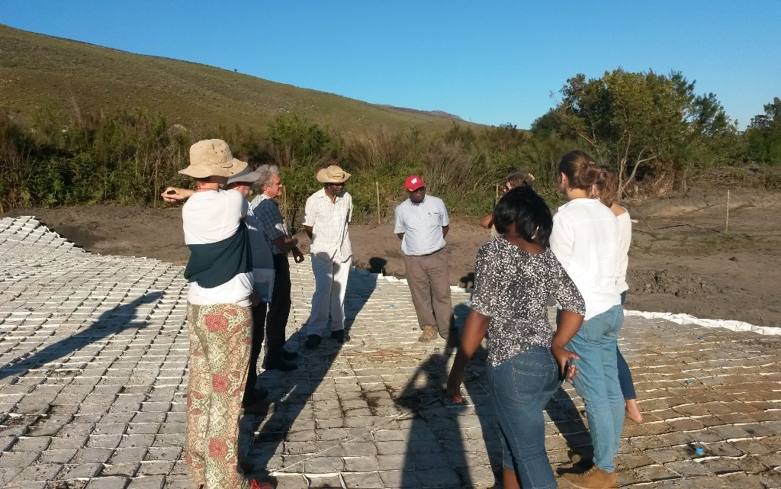
Current Projects: Langkloof & Baviaans
WRC-funded Participatory Hydrological Modelling for collective exploration of water resource protection, restoration and water use managent options in the western Algoa Water Management Area.
Hydrological Model
Water supply planning; flood lines & Protection
“Participatory” – different levels of participation
Trust - Collaborative Decision-making
Notes:
This project is running over 2 years (April 2016 – March 2018) and the main aim of this participatory model building is to foster social learning and group decision-making in catchment management. The focus is not only on the accuracy and applicability of the models themselves, but also the process of model building as a learning tool for the stakeholder group.

Slide 18
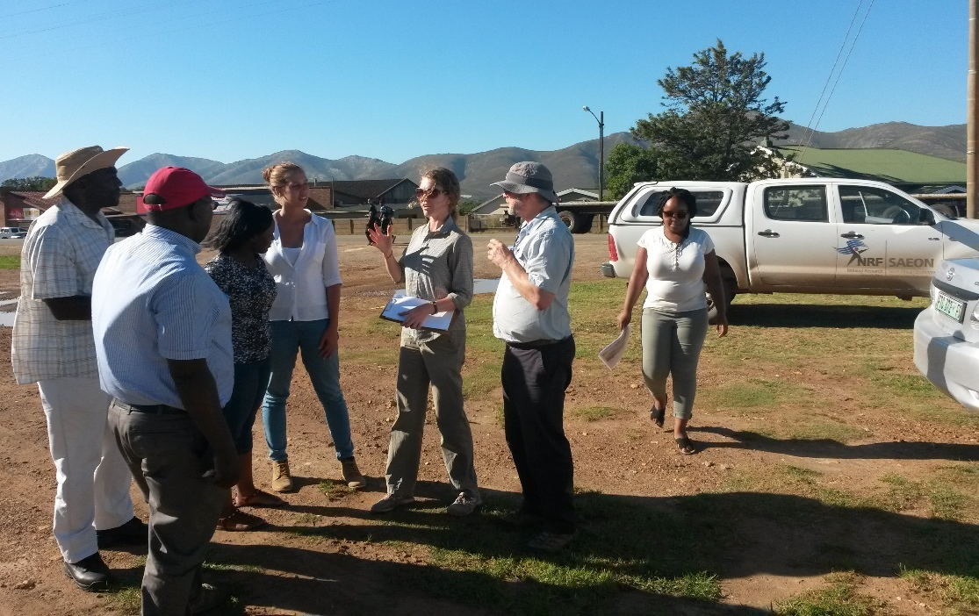
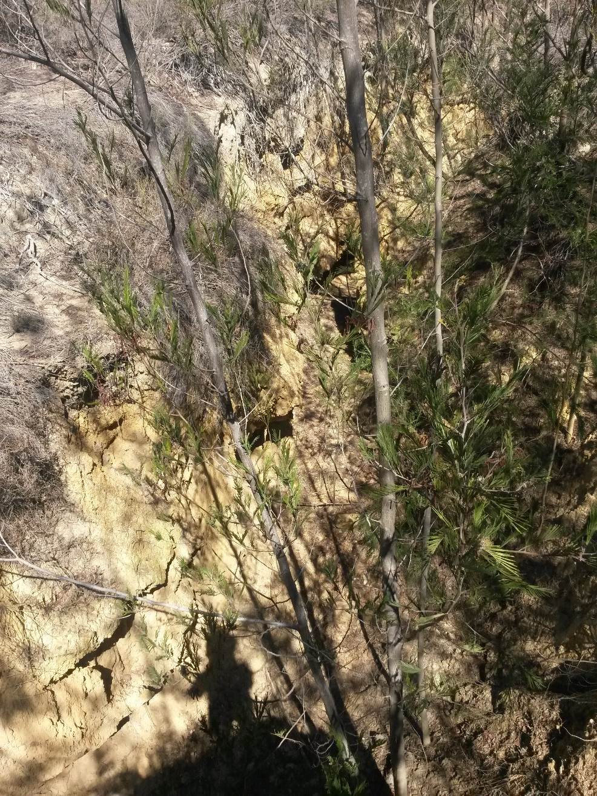
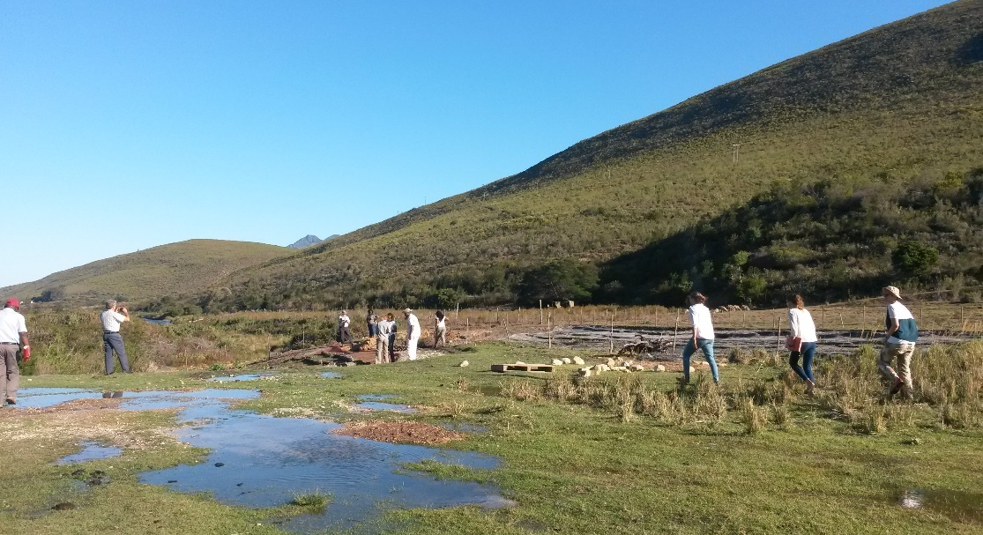
Current Projects: Langkloof & Baviaans
Notes:
This project is running over 2 years (April 2016 – March 2018) and the main aim of this participatory model building is to foster social learning and group decision-making in catchment management. The focus is not only on the accuracy and applicability of the models themselves, but also the process of model building as a learning tool for the stakeholder group.

Slide 19
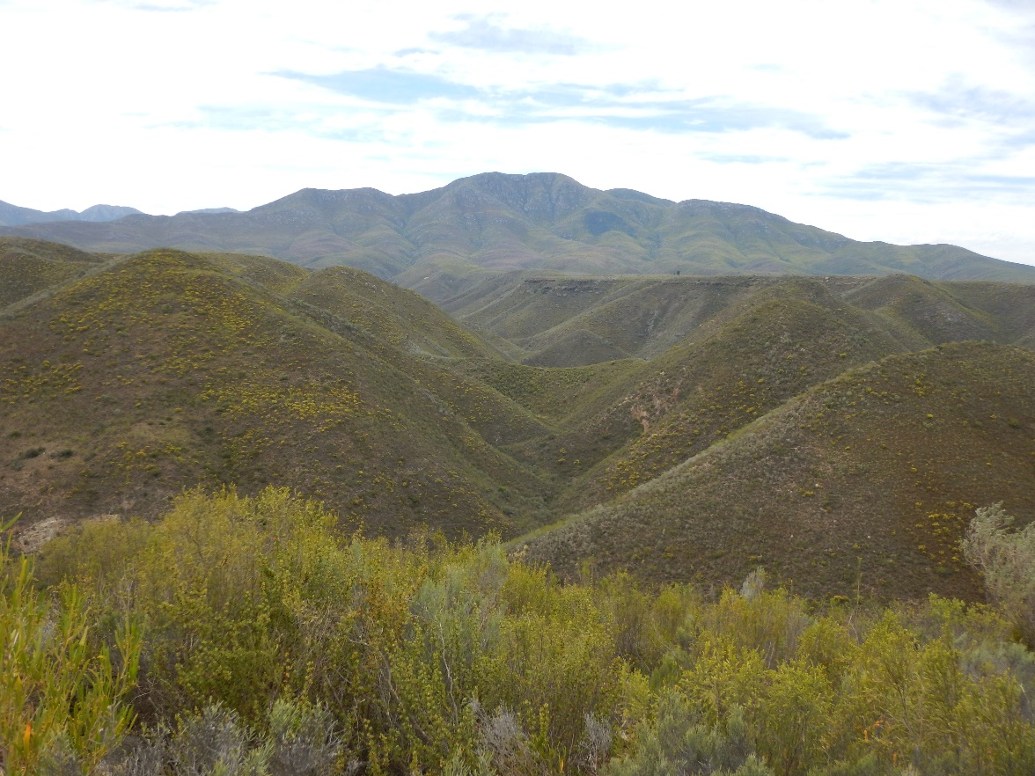
Thank You
Thelani Grant
083 389 7105/ thelani@livinglands.co.za

